Slide 1
Book Justice

Slide 2
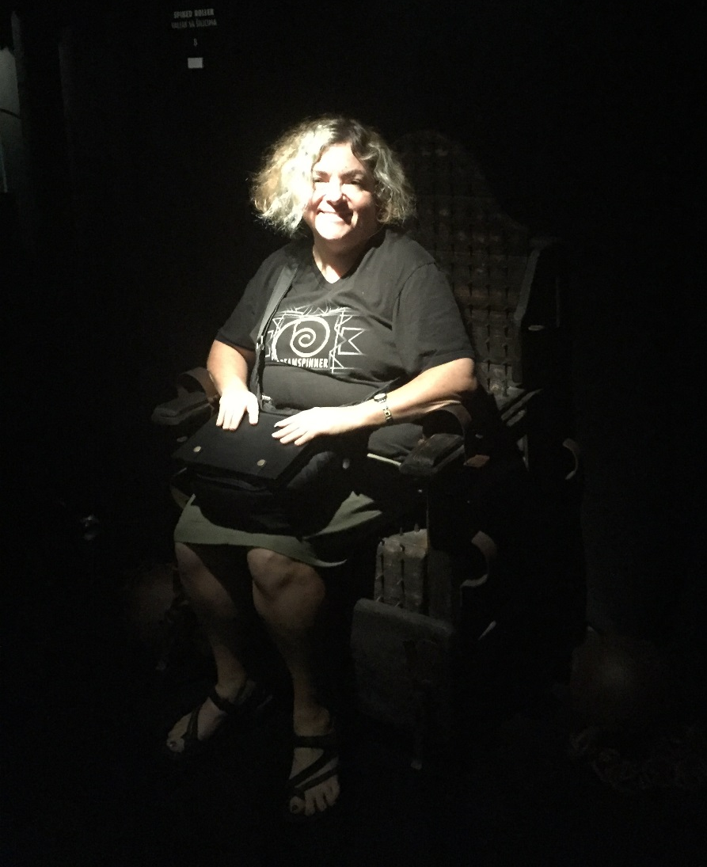
Cops, courts, or corrections. Sooner or later, most of our guys are going to come in contact with the criminal justice system. We'll do a crash course on the U.S. criminal justice system with special emphasis on subjects authors often get wrong--or need to take special care with. We'll leave with a better idea of how to get our guys into and out of trouble, and we're bound to find a few juicy plot bunnies along the way.

Slide 4
Remember to check your jurisdiction’s rules and policies!

Slide 5
Jurisdiction/Fragmentation
City
County
State
Federal
International

Slide 6
Jurisdiction/Fragmentation
18,000 law enforcement agencies
51 court systems
1800 state and federal prisons
3200 local jails

Slide 7
Components of the CJ System

Slide 8
Components of the CJ System
Codes

Slide 9
Components of the CJ System
Codes
Cops

Slide 10
Components of the CJ System
Codes
Cops
Courts

Slide 11
Components of the CJ System
Codes
Cops
Courts
Corrections

Slide 12
Remember to check your jurisdiction’s rules and policies!

Slide 13
Codes

Slide 14
Homicide
Taking the life of a human being
Divided into murder and manslaughter, and each of those is subdivided. What differentiates them is the offender’s intent—with premeditation, willfully, recklessly, etc.
Sentences may range from short term in prison to death

Slide 15
Homicide
Felony murder:
When someone dies in the course of a felony, and when the death is foreseeable, the person committing the felony is liable for 1st degree murder, regardless of whether he intended to kill anyone. Even regardless of whether he committed the fatal act.

Slide 16
Burglary v. Robbery v. Larceny
Robbery is taking property through force or threats of force
Burglary is entering a structure or vehicle with intent to commit a felony
Larceny is taking property without force or threats
Robbery is a more serious offense—it’s classified as a violent crime
A person can be convicted of both burglary and larceny for the same event

Slide 17
Juvie
Jurisdictions vary hugely as to criminal liability for juveniles
Juveniles can be tried as adults; the mechanisms vary
In some states, juvenile offenses may count towards 3 Strikes

Slide 18
Juvie
In some states, juvenile records are rarely sealed

Slide 19
Hate crime
In about half the states with hate crime laws, the laws do not include crimes based on sexual orientation
Even fewer states protect gender or gender identity
Hate crimes are severely underreported
Hate crime prosecutions and convictions are extremely rare

Slide 20
Hate crime
Only ~5% of hate crime offenders belong to organized extremist groups

Slide 21
cops

Slide 22
Science
Most crimes have little or no evidence that can be scientifically examined
It can take a long time to get results. Some labs are backed up for longer than a year.
Science is not infallible.

Slide 23
Lying
Cops can lie about lots and lots of things
Even if asked directly whether they are cops, they can lie about that too
When there are multiple suspects, they can (and do) lie, telling one of them that the other has ratted him out

Slide 24
Missing Persons
Grammar and punctuation be damned—they’re called Missing Persons Reports
People do not have to wait 24 hours to file a report, especially if the missing person is at risk

Slide 25
Miranda
Suspects need to be Mirandized only before they are subjected to custodial interrogation
The wording doesn’t have to be exact
Suspects can waive their rights—and most do
Even juveniles can waive their Miranda rights and can be interrogated without a parent of lawyer present

Slide 26
Warrants
There are arrest warrants and search warrants
Warrants are almost never needed for arrests
The courts have carved out a number of exceptions to the warrant requirement

Slide 27
Warrants
Police virtually never need a warrant to search a vehicle or anything in that vehicle (but do need probable cause)

Slide 28
Warrants
If police have an arrest warrant or are in hot pursuit of a fleeing felon, they can enter any structure if they have probable cause to believe the subject is there. And if the police happen to accidentally catch someone else up to no good while they’re there? Jackpot!

Slide 29
Warrants
If police do not have authority to search, they can always ask the subject for a consent search. They do not need to inform the subject that he has the right to refuse.

Slide 30
Deadly force
Police may use deadly force on a suspect if they reasonably think it’s necessary to protect themselves or others from serious harm.
Even “non-lethal” force (pepper spray, chokeholds, Tasers) may occasionally kill

Slide 31
Constitutional rights
The rights contained within the Constitution protect people only from actions committed by government agents. The Constitution doesn’t restrict the actions of anyone else—eg, private detectives and private companies

Slide 32
Death investigations
Policies, titles, and administrative structure vary widely
Often, the coroner is a law enforcement agent (such as a sheriff). Her job is to investigate suspicious or unaccompanied deaths
The medical examiner is a doctor who conducts the autopsies. That person usually specializes in forensic pathology. His job is to determine cause of death
The medical examiner does not determine manner of death (suicide, accident, natural causes, homicide, etc)
Other forensic specialists may also be consulted (anthropology, entomology, odontology etc.)
The responsible police agency—not the coroner—usually collects other evidence from the scene
They don’t use Vick’s (at least not where I live)

Slide 33
Pressing charges
The decision about whether to press charges almost never is up to the victim—it’s up to the prosecutor
The victim can decide whether to report and how cooperative to be with the investigation
Prosecutors can file charges even if the victim doesn’t want them to

Slide 34
Fragmentation
Compared to local policing, federal law enforcement involvement in crimes is rare.
Multiple agencies may have jurisdiction over a particular offense. They usually cooperate, especially if they’re local.

Slide 35
Fragmentation
Small towns may contract with larger agencies for things like homicide investigations.

Slide 36
courts

Slide 37
Pleas
There are only three possible pleas:
Guilty
Not guilty (not “innocent”)
No contest

Slide 38
Plea bargaining
Only about 5% of arrests result in a trial
Most cases are plea bargained
Despite this, court backlogs can be very long
The decision whether to accept a plea deal may be difficult

Slide 39
Accomplice liability
Those who assist before or during the commission of a crime are called accomplices and may be subject to the same sanctions as the primary offender
Those who assist afterward—eg, in hiding the suspect or destroying evidence—are usually charged as accessories after the fact. They generally face lesser charges such as obstructing justice.

Slide 40
Insanity defense
Is very rarely used
Is successful only about 25% of the time
Standards for insanity vary but all are very different from psychological or psychiatric definitions of mental illness
Some states have no insanity defense
Defendants who are successful with the defense will generally be detained in a mental institution until they are deemed to no longer be a danger to themselves or others

Slide 41
Double jeopardy
Prohibits trying or punishing someone more than once for the same offense

Slide 42
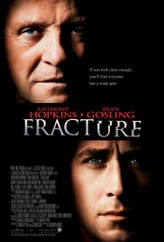
Double jeopardy
Sometimes it’s fuzzy whether a second offense can be charged
Double jeopardy doesn’t stop different states (or the feds) from prosecuting someone who’s already been tried for an offense (dual sovereignty)
The right to double jeopardy attaches as soon as the jury is sworn in at trial, but a defendant can usually be retried if a mistrial occurs
The right means that once a defendant is acquitted, he can’t be tried again for that same offense, even if wonderful new evidence materializes

Slide 43
Verdict
Only two verdicts are possible:
Guilty – The jury finds that the prosecutor has proven every element of the crime beyond a reasonable doubt
Not Guilty – The jury finds that the prosecutor has failed to prove at least one element beyond a reasonable doubt
Note: Defendants are not found “innocent”

Slide 44
Corrections

Slide 45
Jails v. Prisons
Jails
are usually run by city or county law enforcement agencies
house pretrial detainees who couldn’t bail out
house people who have been convicted of misdemeanors and are serving less than a year

Slide 46
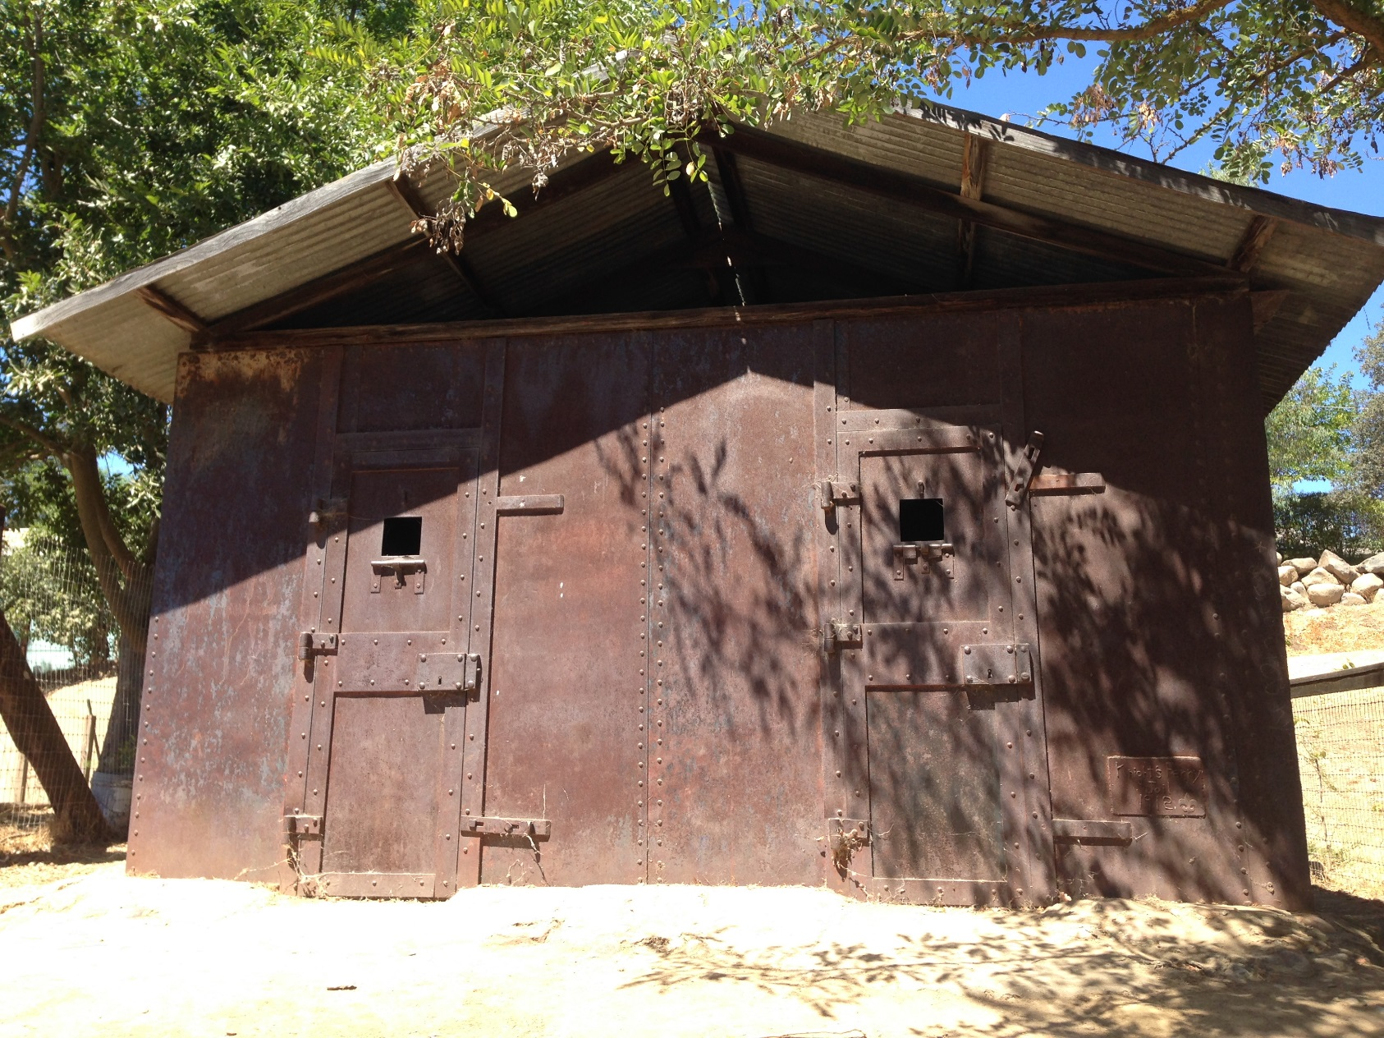
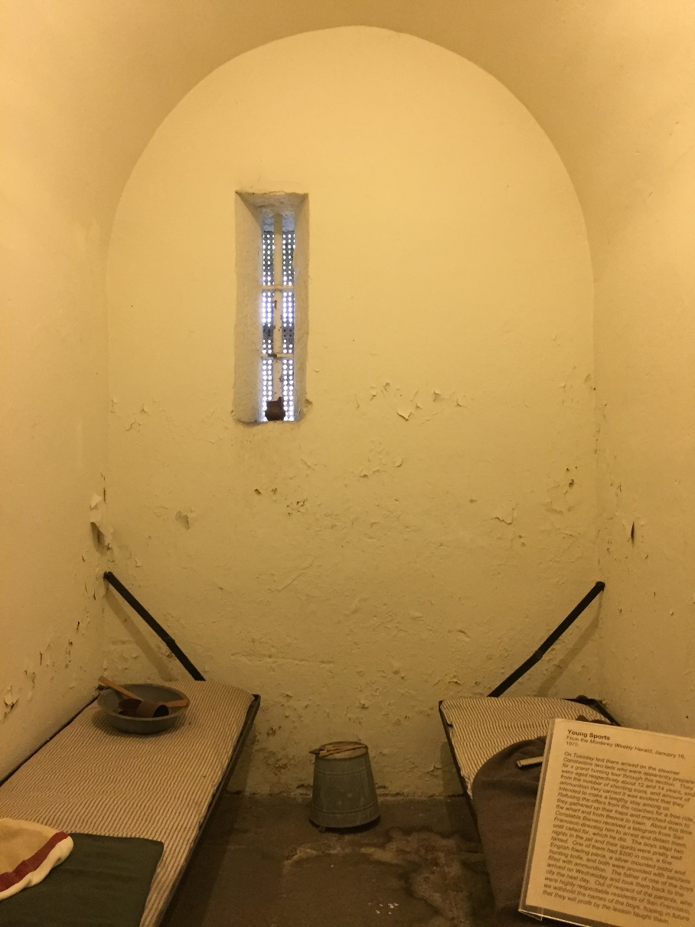
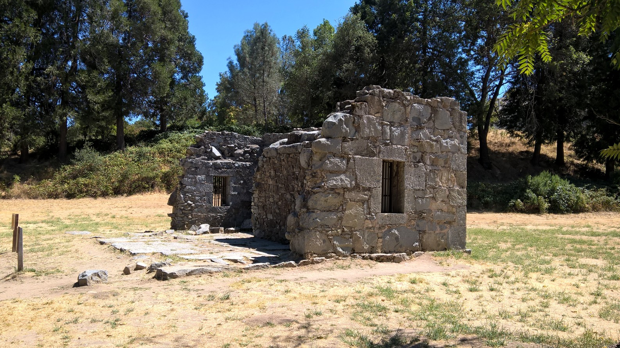
Jails v. Prisons

Slide 47
Jails v. Prisons
Prisons
are usually run by state or federal agencies (or private corporations)
house people convicted of felonies who are serving more than a year
range from minimal security to Supermax

Slide 48
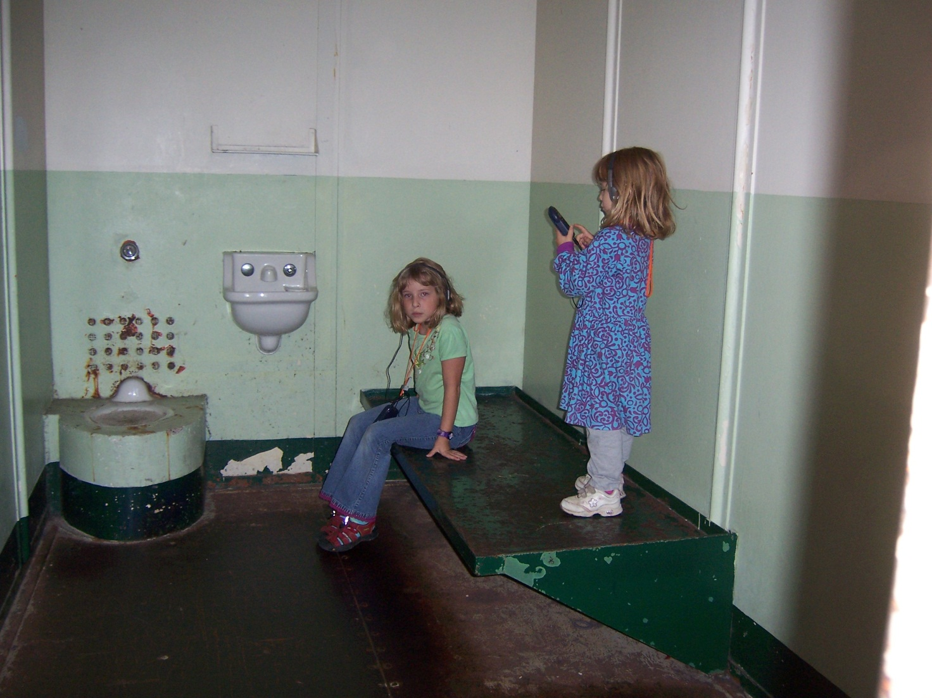
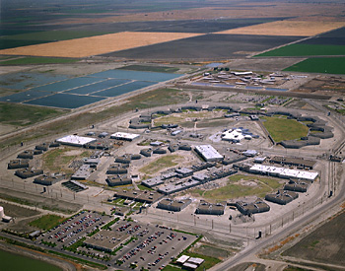
Jails v. Prisons

Slide 49
Probation v. Parole
Probation is when a person is given supervised release instead of incarceration. It’s one of the most common sanctions. Length of probation, degree of supervision, and conditions of probation vary. If the probationer violates the conditions, he’ll end up incarcerated.
Parole is when a felon is released early from prison. Parolees are generally supervised closely. If they violate their parole conditions, they go back to prison.

Slide 50
Conjugal visits
Only four states (California, Connecticut, New York and Washington) allow conjugal visits
Even there, few inmates are eligible
California and New York explicitly allow conjugal visits from same-sex partners.
The couple must have been married or in a domestic partnership prior to incarceration.

Slide 51
Remember to check your jurisdiction’s rules and policies!

